Slide 1
Finding the best location to open the food court in Ahmedabad, Gujarat, India
This ppt is part of the coursera capstone project week 5

Slide 2
Contents
Introduction
Data acquisition and cleaning
Data analysis
Conclusion

Slide 3
Introduction:
Business Problem: to find the best location in Ahmedabad city to open food court business far from existing food courts but near to target customers which are university students and youngsters.
Technology Used: Foursquare
Geopy
Folium

Slide 4
Data acquisition and cleaning
The only time data cleaning is needed is while getting the data in json format from foursquare and converting into a data frame.
Although the same process is done thrice as there are three data frames used in the project. 1. all existing food courts in Ahmedabad 2. All universities and colleges in Ahmedabad 3. all theatres in Ahmedabad.

Slide 5
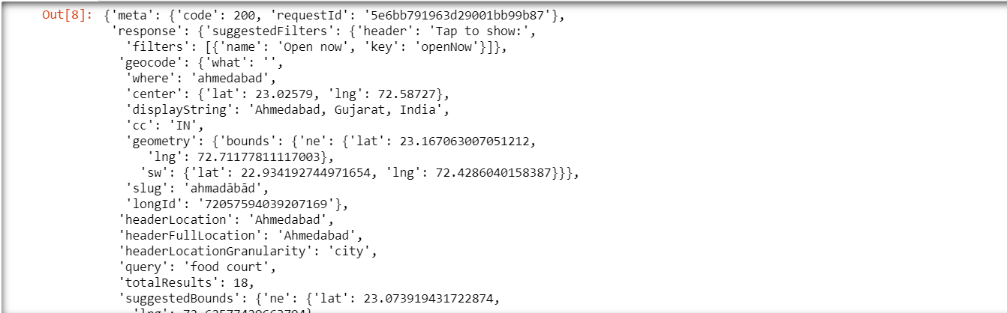
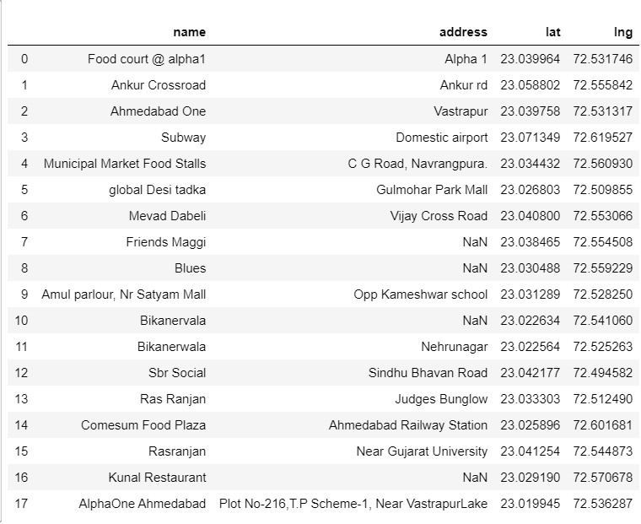
Data acquisition and cleaning

Slide 6
Data analysis
First, mark all existing food courts using red markers in Ahmedabad map.
Second, mark all universities and colleges using green markers in same map.
Third, mark all theatres using yellow markers in the same map.
Circle boundaries of 2.5 kms around the existing food courts.

Slide 7
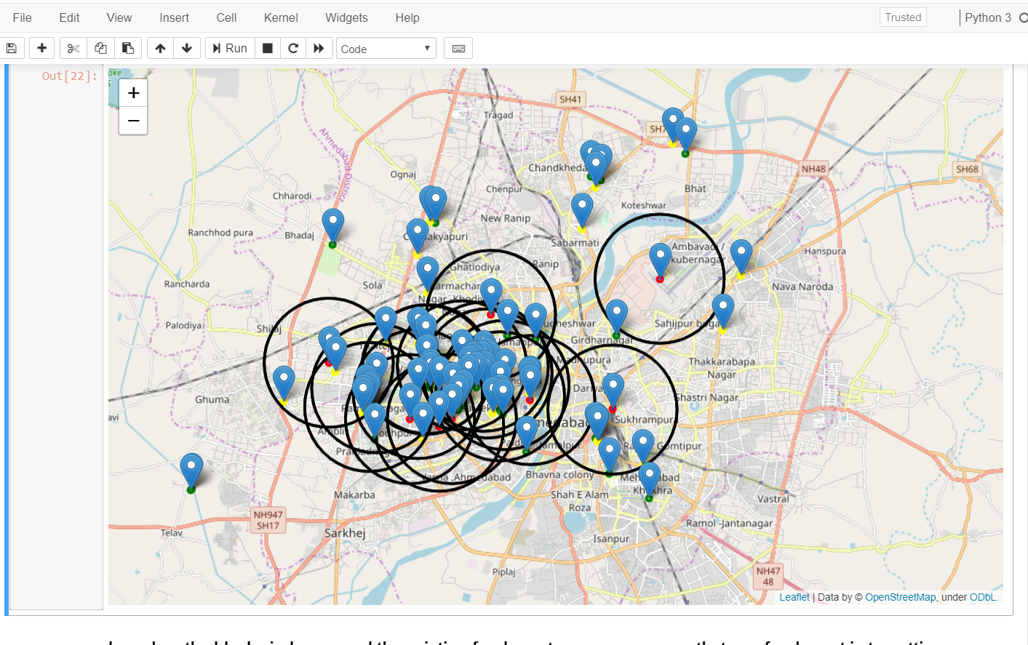

Slide 8
Conclusion:
Result: based on the map with all processes, two locations are best match for our business problems. Chandkheda and Chanakyapuri. As both locations are far from existing food courts and also includes 2 universities and 2 theatres in the near area. So if establishing the business over here, we can attract the students from both universities and on weekend youngsters usually watch movies and dine outside which will fulfil our requirements.

Slide 9
THANK YOU

